Slide 1
Relational Algebra (Part-3)
20.2

Slide 2
Contents
Select

Slide 3
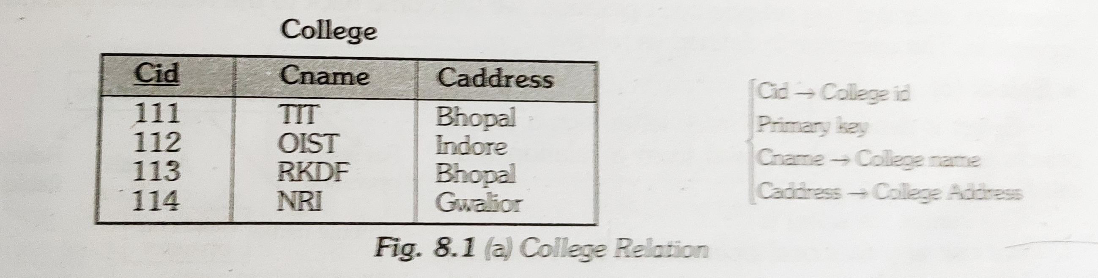
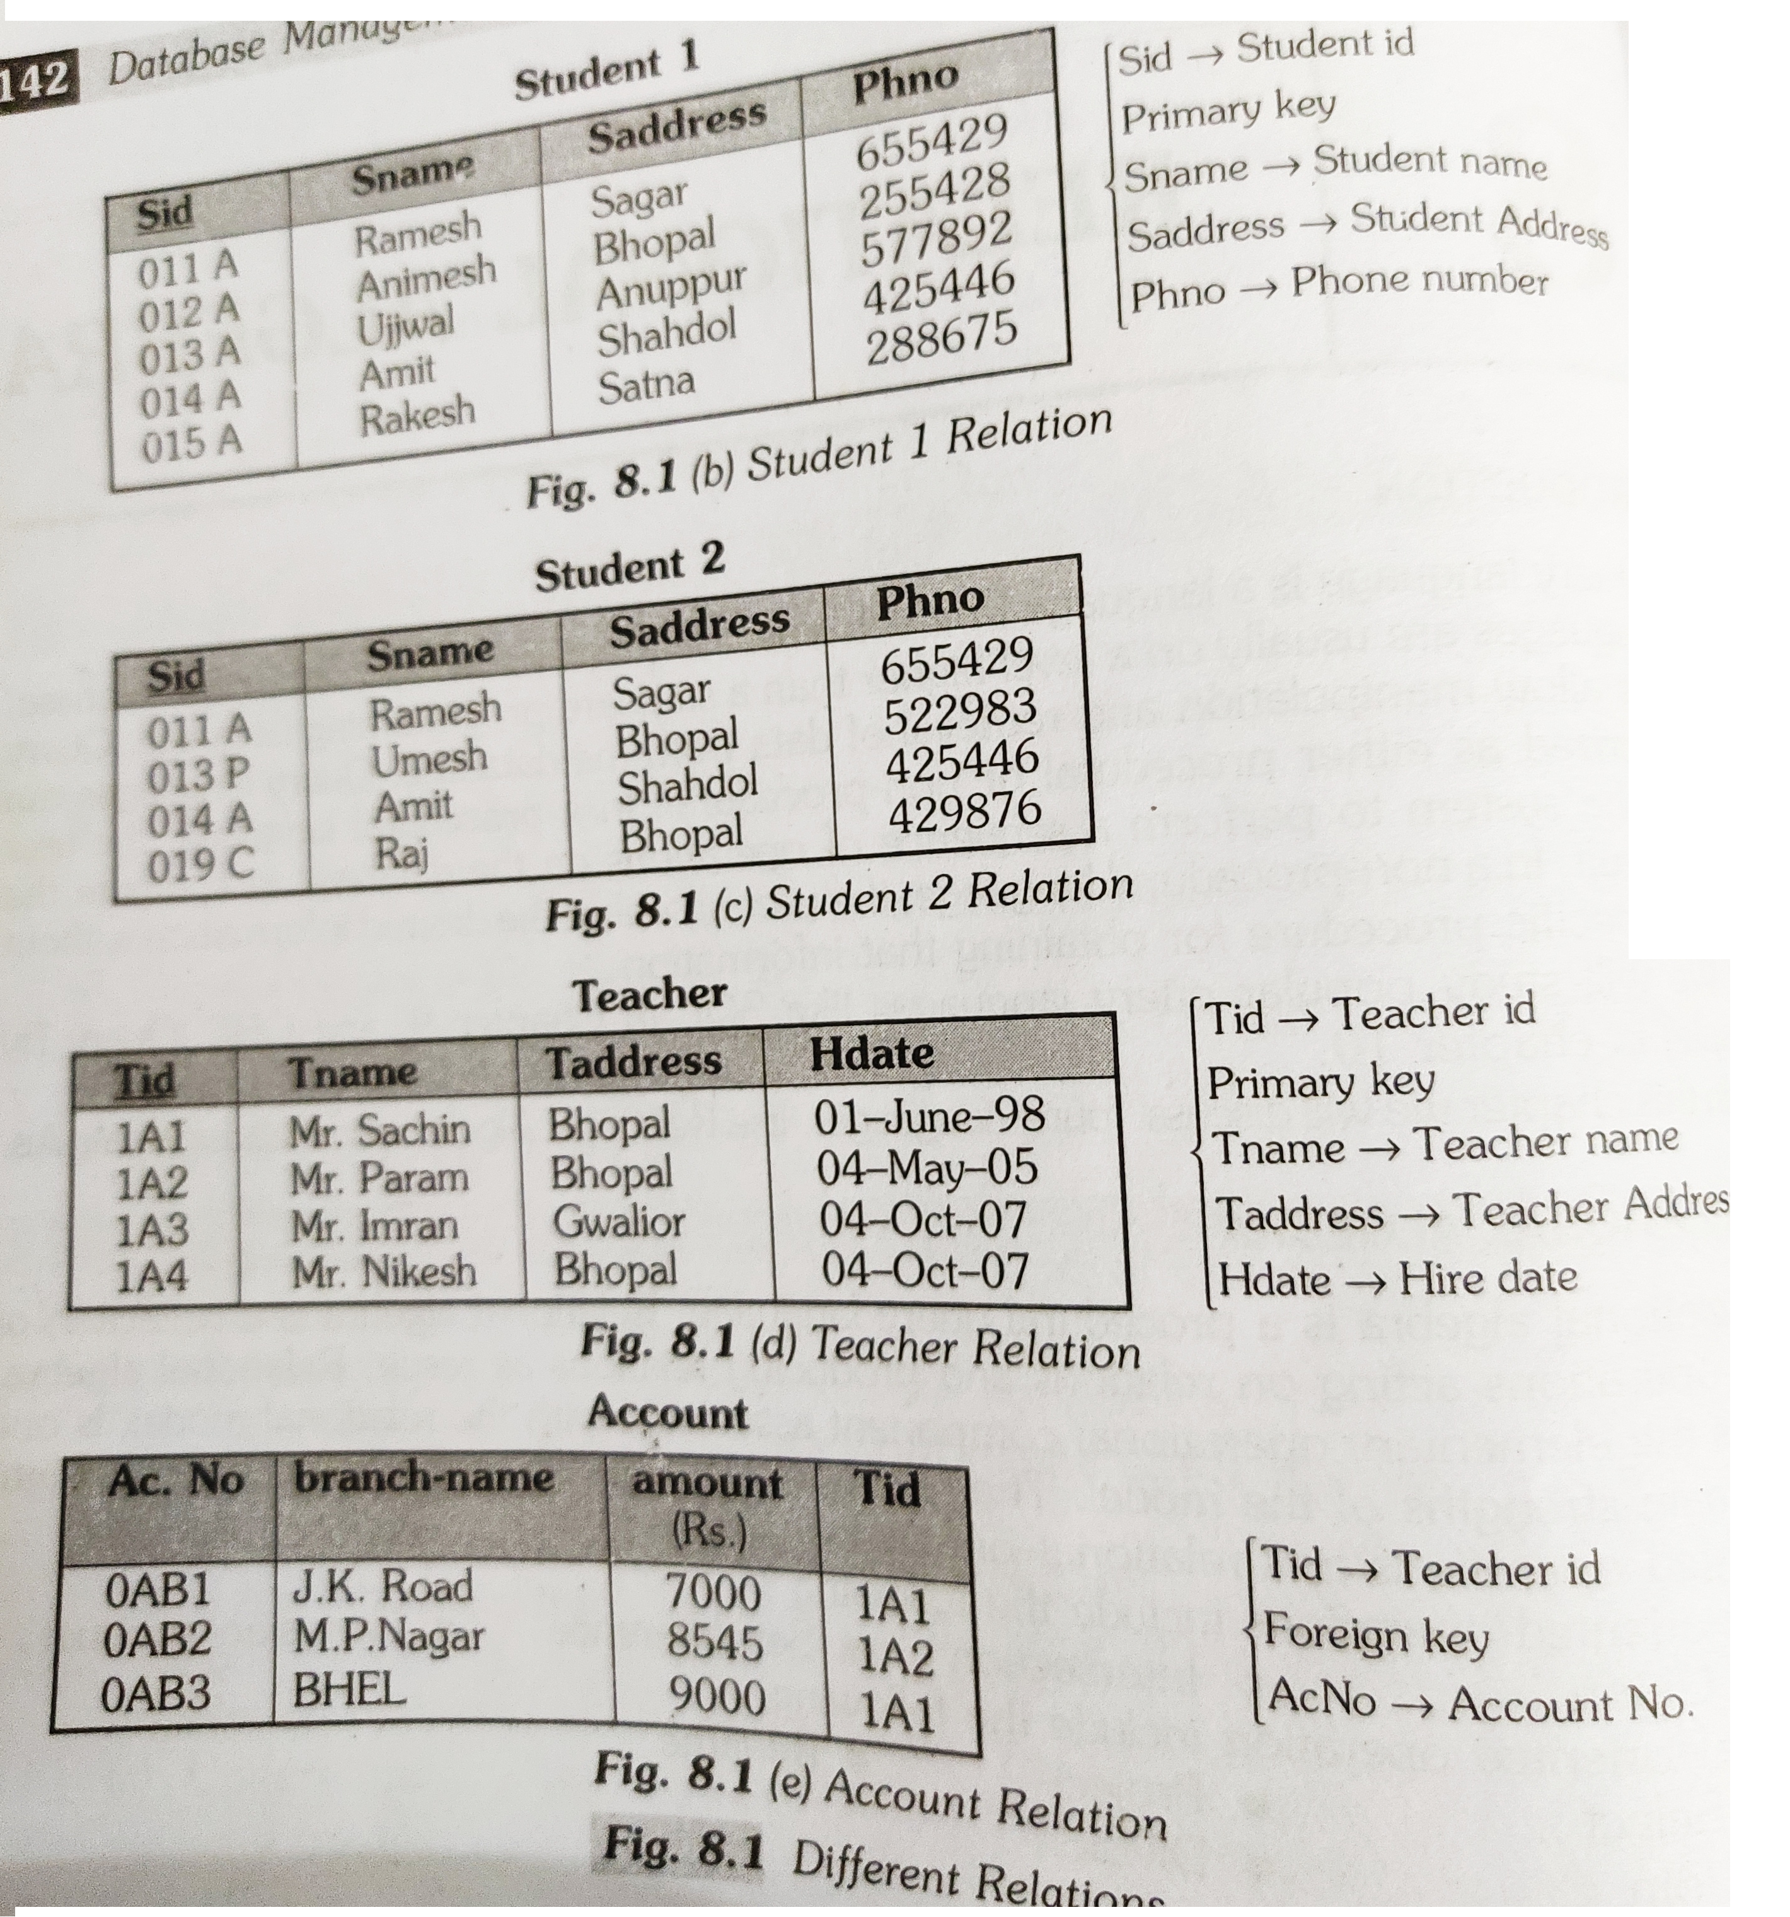
Select

Slide 4

Select
Select operation chooses the subset of tuples from the relation that satisfies the given condition mentioned in the syntax of selection. The selection operation is also known as horizontal partitioning since it partitions the table or relation horizontally.
where ‘c’ is selection condition which is a Boolean expression(condition), we can have a single

Slide 5
Select
R is a relational algebra expression, whose result is a relation. The boolean expression specified in condition ‘c’ can be written in the following form:
<attribute name> <comparison operator> <constant value> or <attribute name>

Slide 6
Select
<comparison operator> is any of the operator {<, >, =, <=, >=, !=} and,
<constant value> is constant value taken from the domain of the relation.
It is a unary operation because its works on one relation.

Slide 7
Select

Slide 8


